Slide 1
Microprocessor
The microprocessor
is a programmable chip that can perform very basic functions namely (a) data transfer between itself, memory and I/O devices (b) arithmetic operations (c) boolean decisions.
Through a program which is a logical arrangement of basic operations, the microprocessor can be made to accomplish very complex tasks.
The microprocessor is the controlling element in a computer and is also referred to as CPU.

Slide 2
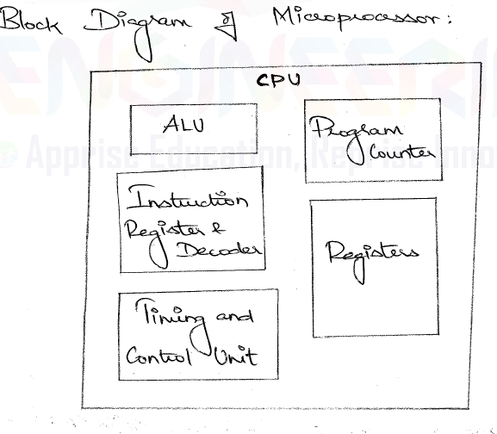
Microprocessor……..

Slide 3
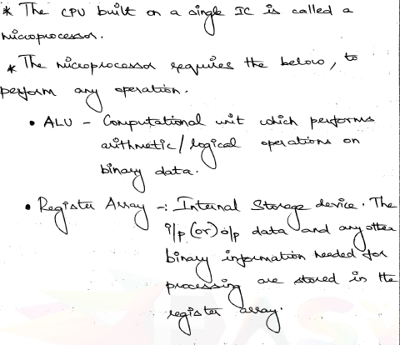
Microprocessor………….

Slide 4
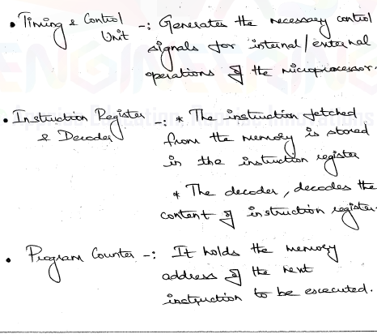
Microprocessor………….

Slide 5
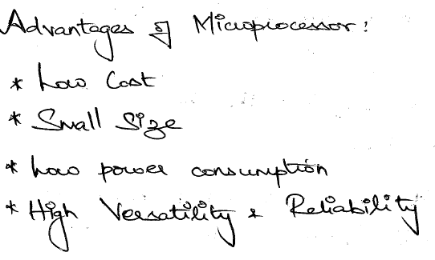
Microprocessor…………

Slide 6
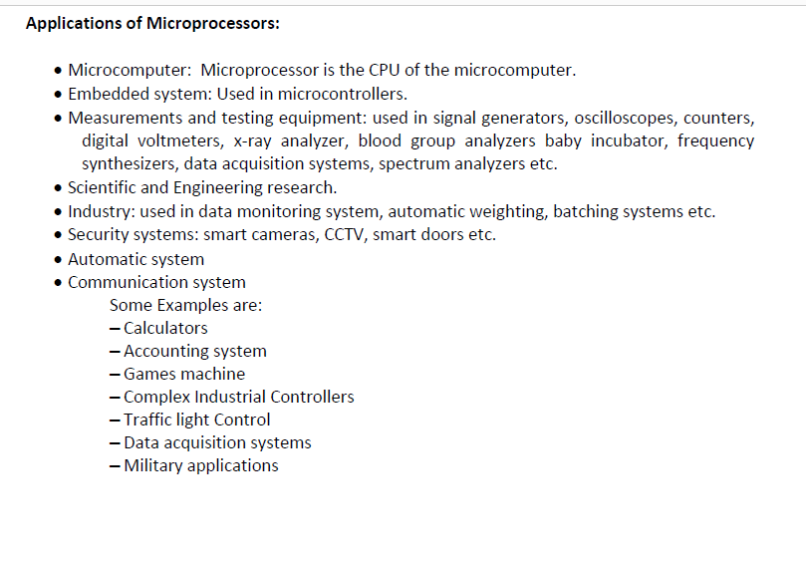
Microprocessor………

Slide 7
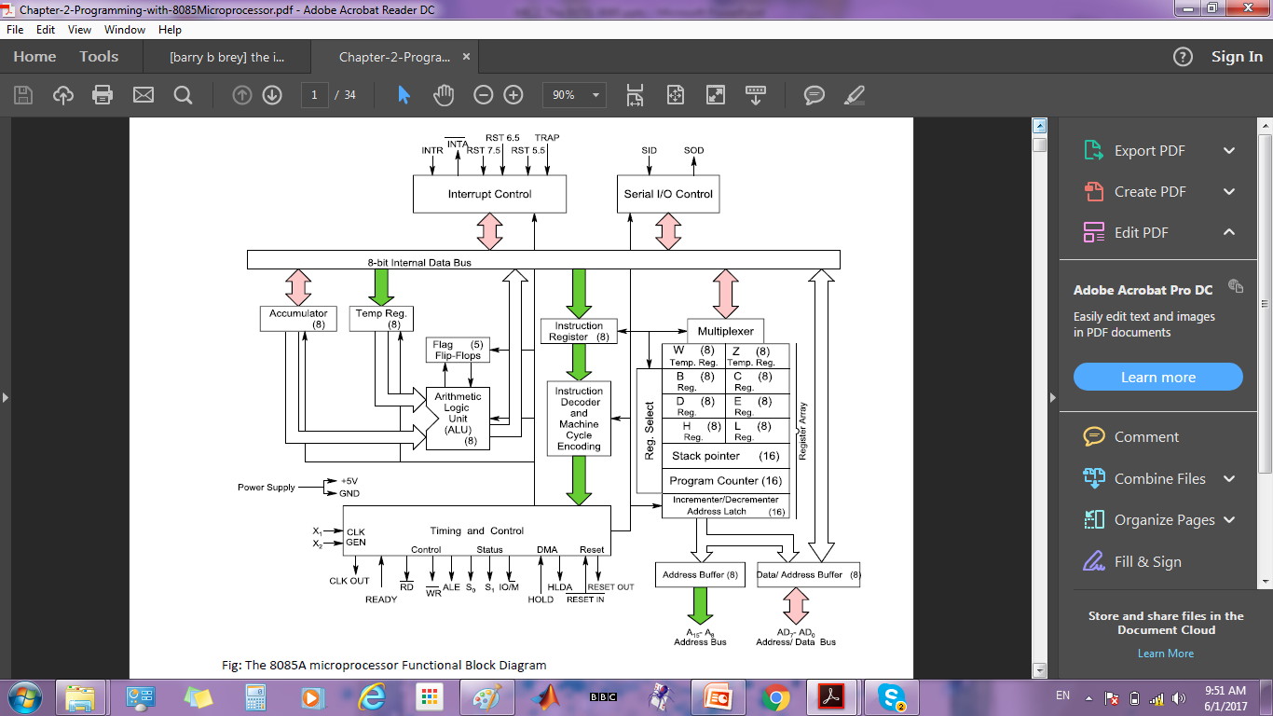
Internal Architecture of 8085

Slide 8
Arithmetic Logic Unit [ALU]: A combinational circuit that performs the basic computations as per instructions.
Accumulator [A]: A program-visible register that always contains the first operand to the ALU and the results of the ALU. The second operand is placed in a program-invisible temporary register.
Program-visible registers [B,C,D,E,H,L]: These are used by the programmer as scratch-pad registers to provide accessory data for instructions and as pointers
Program-invisible registers [W,Z]: These are used by the microprocessor as scratch-pad registers to place temporary data.
Stack Pointer [SP]: contains pointer to the tip of the stack, a special area in the memory with a special purpose.
Program Counter [PC]: contains the address of the next instruction to be executed.
Instruction Register [IR]: After instruction fetch, the instruction opcode is placed in the IR for decode.

Slide 9
Instruction Decoder: A part of the control unit whose objective is to decode the current instruction in the IR.
Timing and Control: A part of the control unit whose objective is to synchronize all microprocessor operations with the clock and generate the control signals, such as RD, WR, as per the current instruction.
Interrupt Control: Its functionalities include setting priority among various interrupt signals such INTR, RST5.5, RST6.5, RST7.5 and TRAP; enabling and disabling interrupts; masking interrupts and generating the acknowledge signal INTA.
Serial Control: It controls serial communications, transmission from SOD and reception from SID.

Slide 10
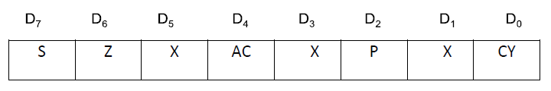
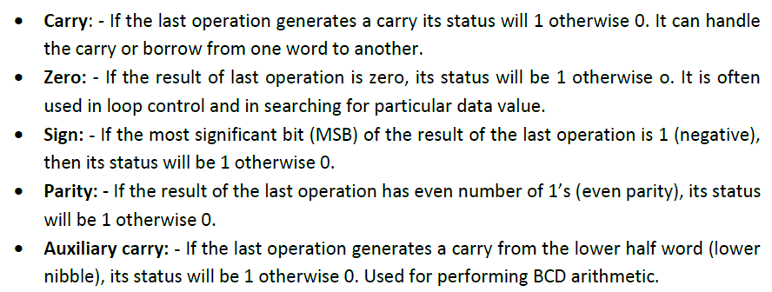
FLAGS

Slide 11
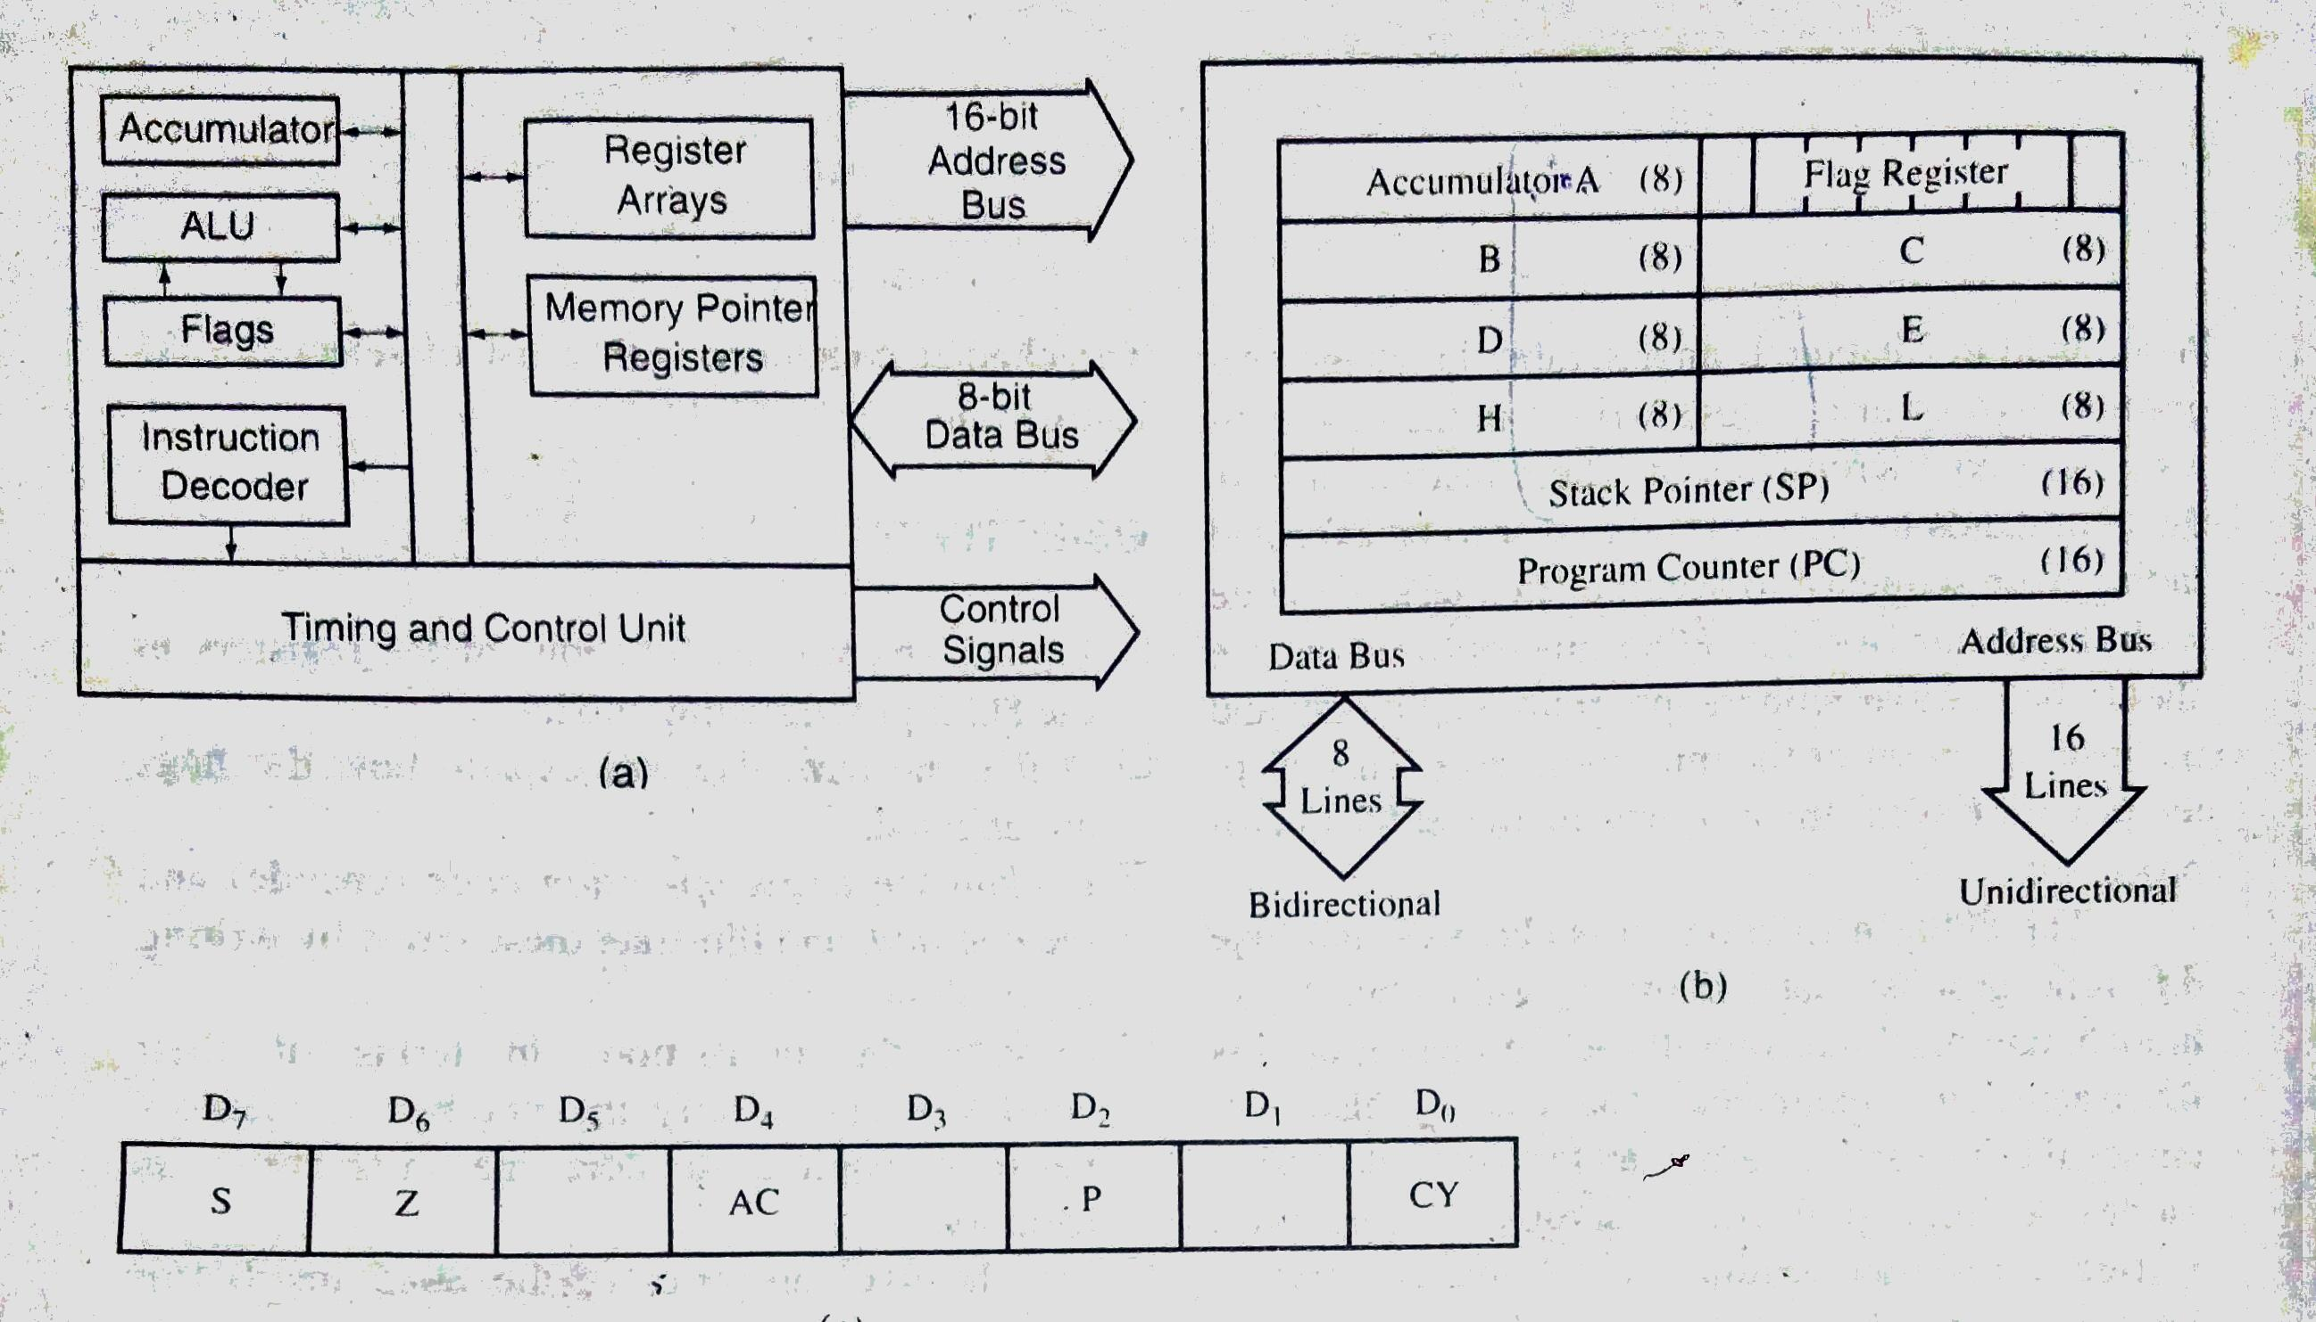
Programming Model of the 8085

Slide 12
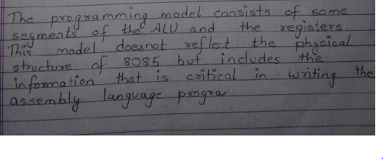
Programming Model of the 8085………………….

Slide 13
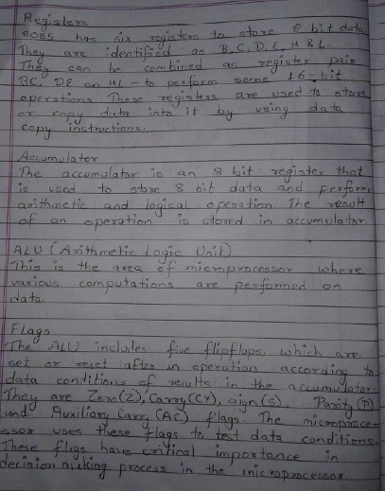
Programming Model of the 8085………………

Slide 14
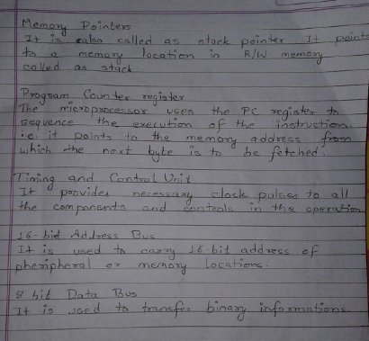
Programming Model of the 8085……………………….

Slide 15
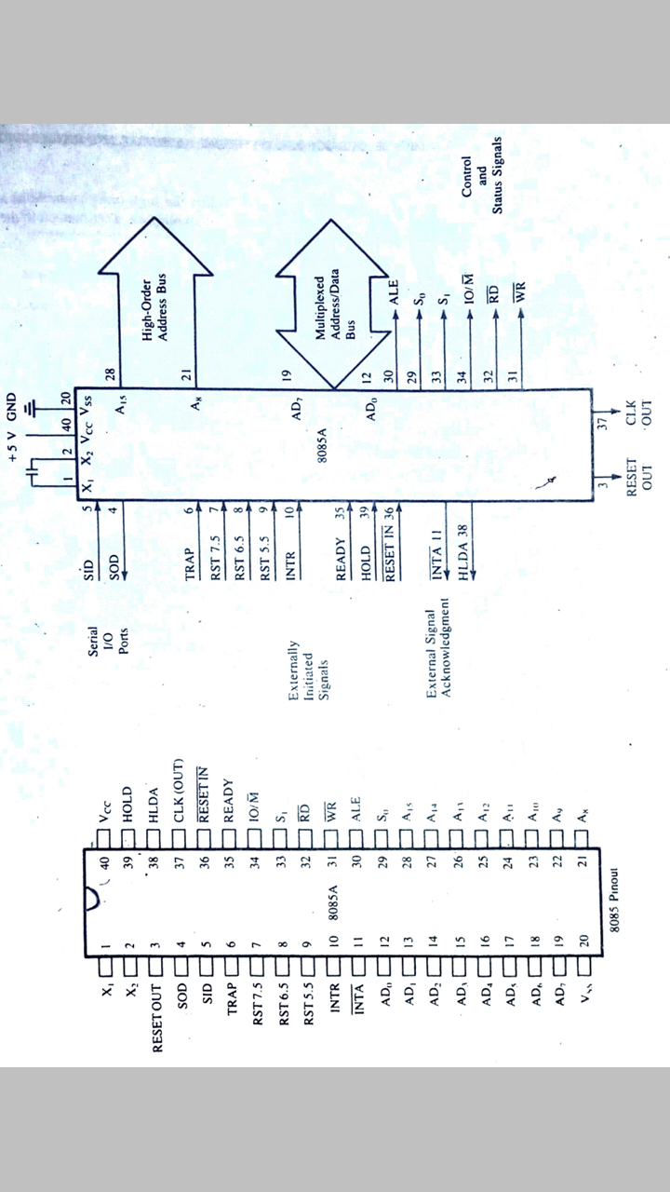
Microprocessor………………

Slide 16
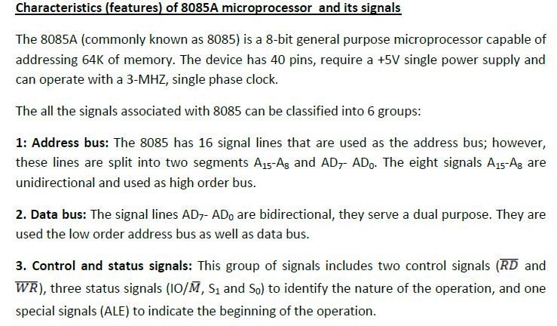
Microprocessor……………………..

Slide 17
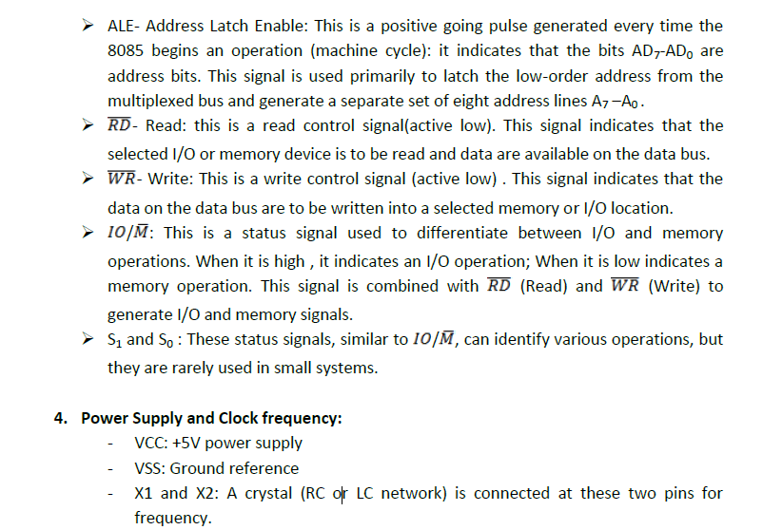
Microprocessor……………………….

Slide 18
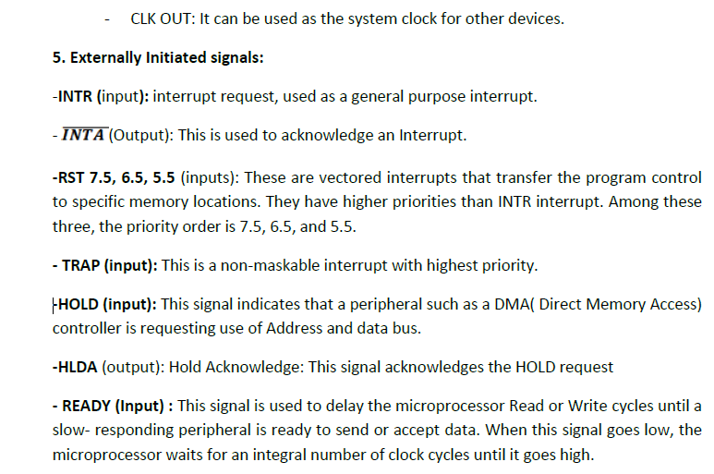
Microprocessor……………………..

Slide 19
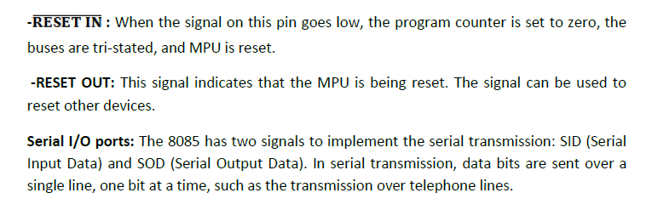
Microprocessor…………………..

Slide 20
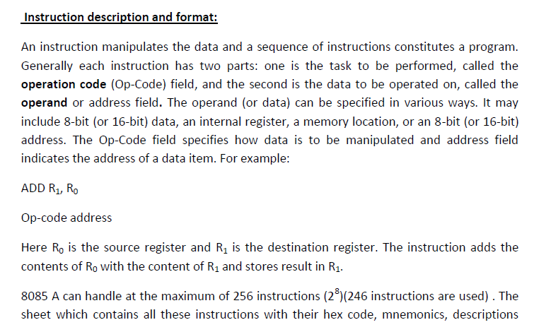
Microprocessor………………………

Slide 21
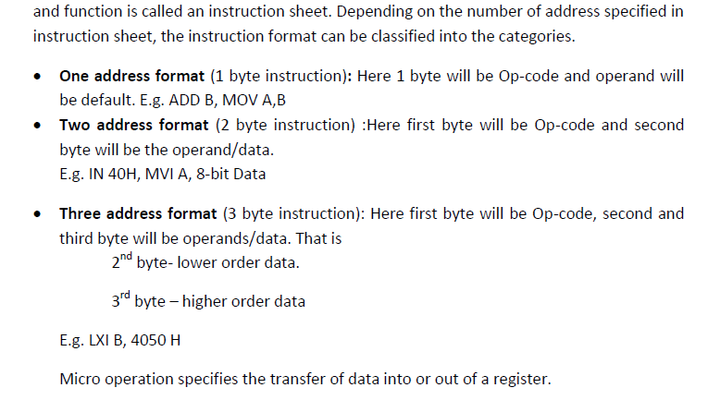
Microprocessor………………………

Slide 22
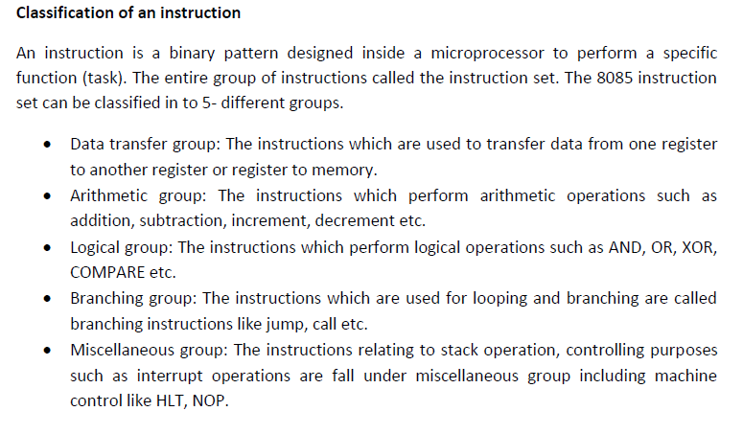
Microprocessor………………………..

